Slide 1
FLS Unit 5
by Justin Ehly
Tuesday, 630p

Slide 2
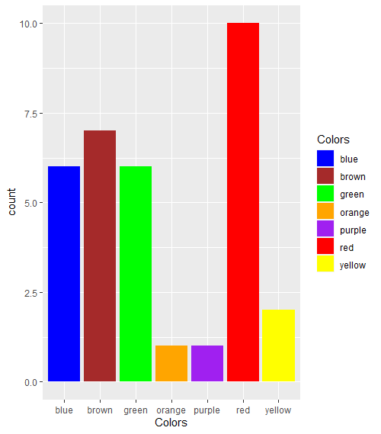
Answer to 5.5
A: we need to add spaces before and after the pipe so that R knows we are only looking for the color words and not as part of other words.
colors = c("orange", "blue","yellow", "green", "purple", "brown", "red")
color_expression = str_c(colors, collapse = " | ") #add space to isolate color word
color_expression
has_color = str_subset(sentences, color_expression)
matches = str_extract(has_color, color_expression)
matches_all = str_extract_all(has_color, color_expression, simplify = TRUE)
matches_all
class(matches_all)
matches_all = unlist(str_extract_all(has_color, color_expression))
matches_all = trimws(matches_all) # remove the spaces around the word for sorting
matchDF = data.frame(Colors = matches_all)
matchDF %>% ggplot(aes(x = Colors, fill = Colors)) + geom_bar() +
scale_fill_manual(values=colors[order(colors)])

Slide 3
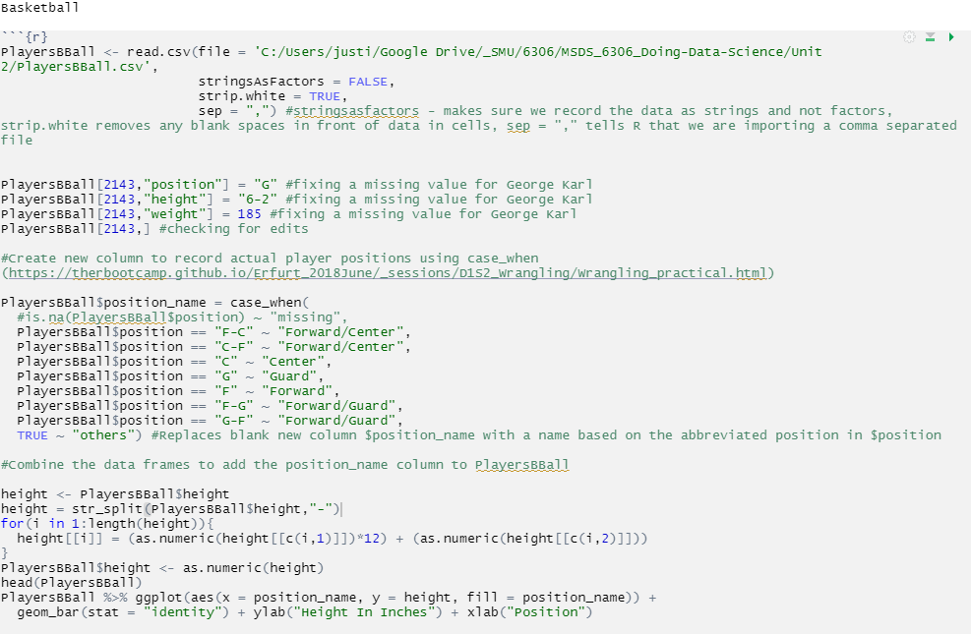
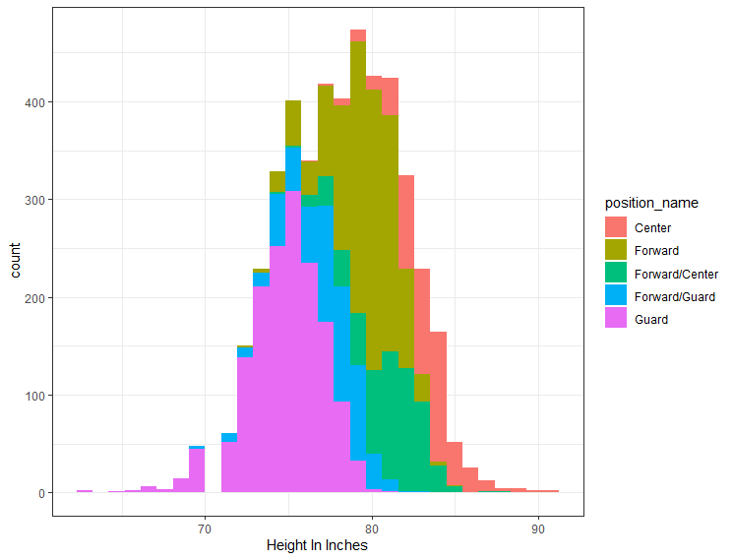
BBALL Study

Slide 4
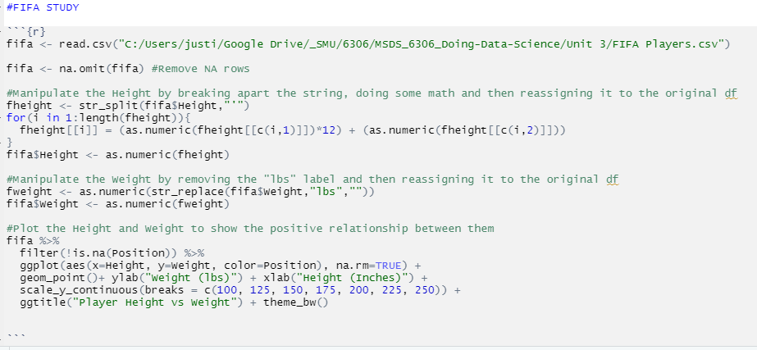
FIFA DATA – Wrangle Data

Slide 5
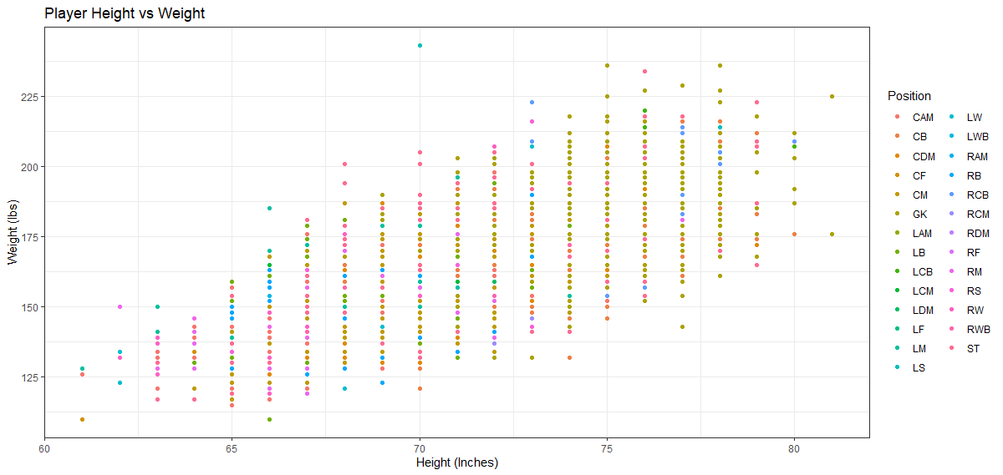
FIFA DATA – Plot it!

Slide 6
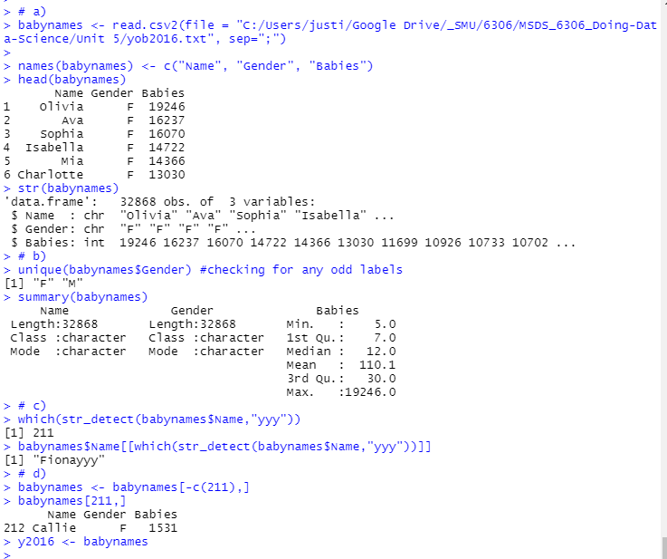
Baby Names 1

Slide 7
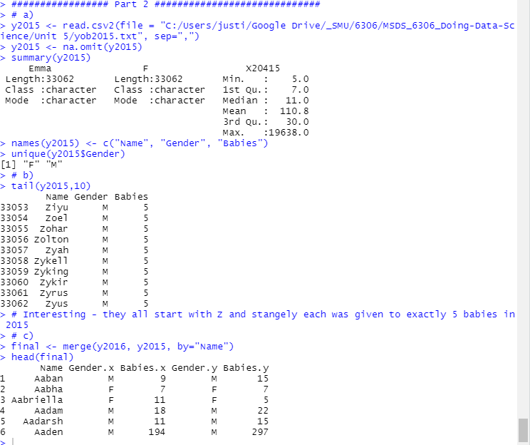
Baby Names 2

Slide 8
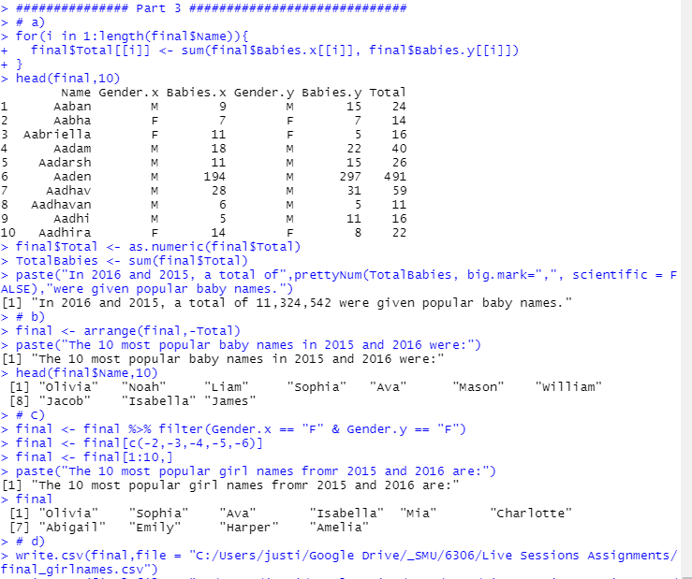
Baby Names 3

Slide 9
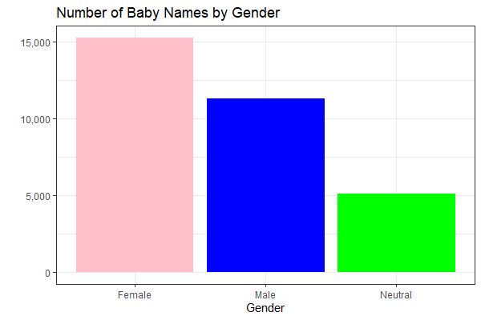
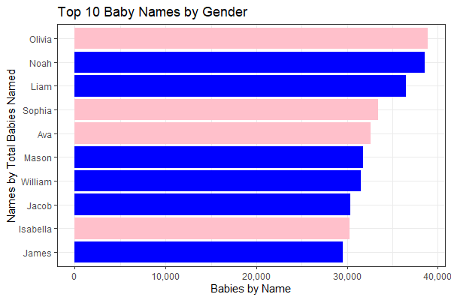
Baby Names 4

Slide 10
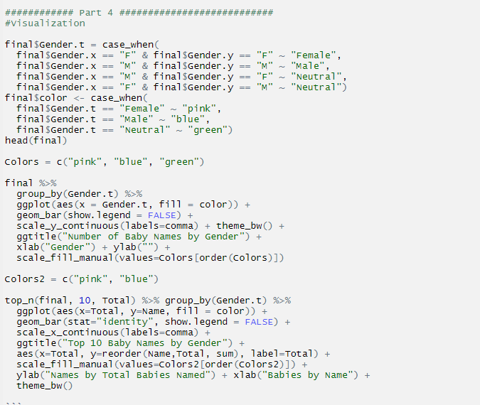
Baby Names 4 Code

Slide 11
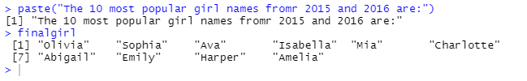
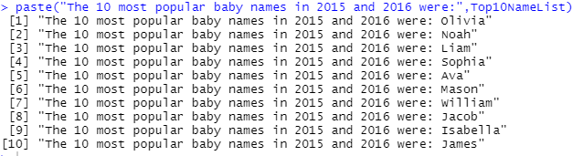
Takeaways
Using string functions to tidy data
Efficiently using existing lists to do math and recombine data into more useful formats (heights to inches)
Arrange()
Q. Still not fully comfortable with Sapply and Vapply vs. using for loops or while/ if_else statements
Q. Still not sure how to get things to format properly using paste, writeLines, etc in the frame so I can combine text with calls from a df.
VS.

